Slide 1
Impacts of the “Winter Crisis” and Covid on Scotland’s Hospital Sector
Public Health Scotland - Dashboard and Analysis
By Chris, Rob, Sarah and Jack

Slide 2
Overview

Slide 3
Overview
Topics to explore:
What impact has the winter had on the hospital (acute care) sector?
What impact has covid had on the hospital sector?
What are the risks of winter during covid?
Data & related ethics:
Open Source Data from Public Health Website
Free to be analysed by anyone for any purpose
Data is aggregated in a way which anonymises individuals
Analysis presents the actual data and any metric calculated from this data

Slide 4
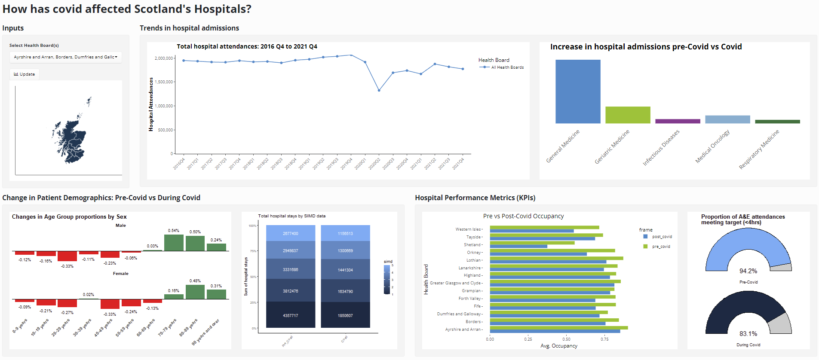
PHS - Dashboard

Slide 5
Demographics

Slide 6
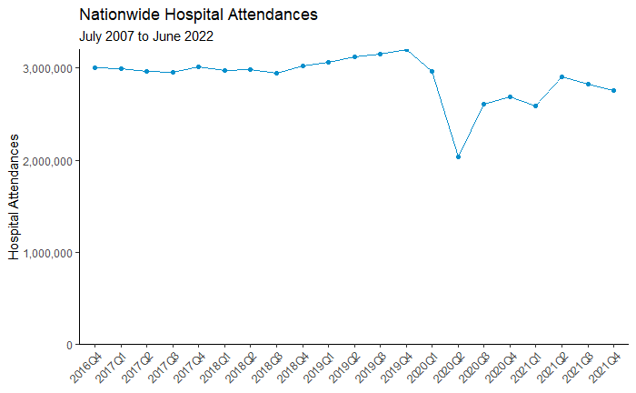
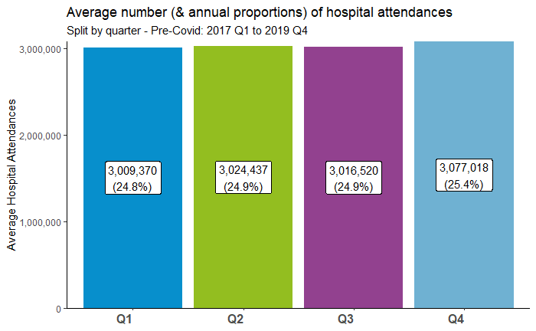
Total Hospital Admissions
Pre-Covid
During Covid
Notes:
Hospital attendances consistent across each quarter
Marginal increase in Q4 hospital attendances (~2% higher than Q1-Q3)

Slide 7
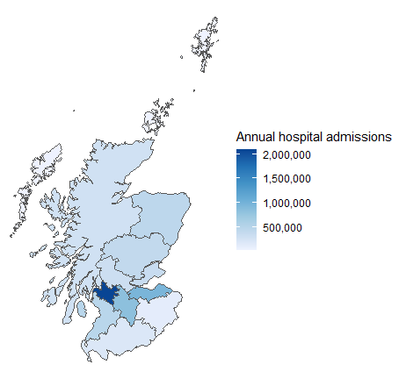
Geographic
Largest number of hospital admissions in the Central Belt:
Greater Glasgow & Clyde
Lothian
Lanarkshire
Arran and Ayrshire

Slide 8
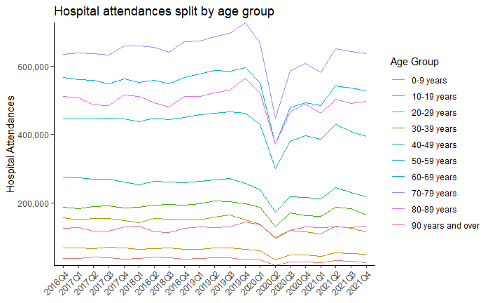
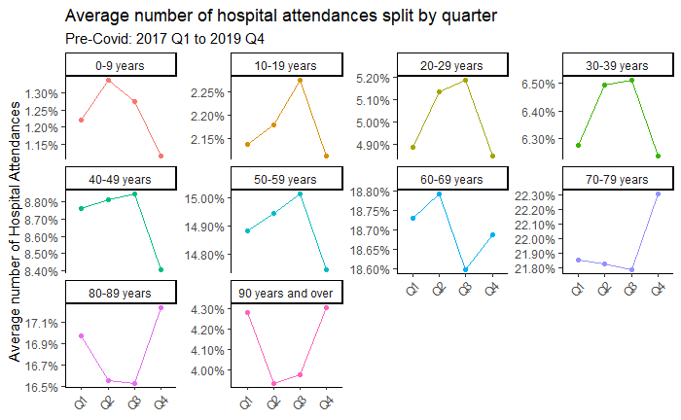
Demographics: Who gets admitted to hospital…
Notes:
Apologies to anyone who has eyes as you may find this a bit difficult to read, so let me help you!
Note difference in segmenting ages
Age Brackets spanning 50 - 89 is the most largest being admitted to hospital
Spike in Under 5’s
Linked to second Covid “wave”?
Increase in births?
Not super clear but good for illustrative purposes, the graph below shows that all age groups <60 years have a significant drop in the proportion of hospital visits in Q4 (winter). The opposite can be seen for over 60s where there is a significant spike in Q4 (this effect is amplified the older the age group).

Slide 9
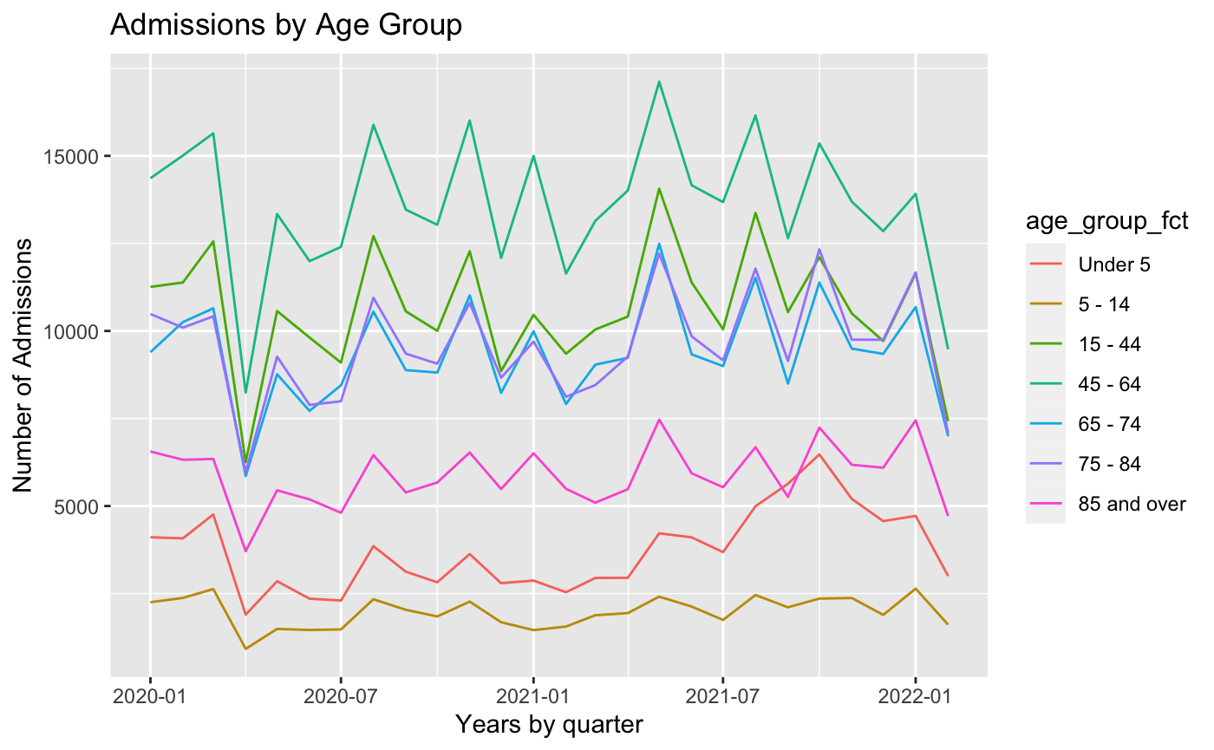
Demographics: Who gets admitted to hospital…
Age Brackets spanning 15 - 45’s largest cohort being infected and being being admitted to hospital
Spike in Under 5’s
Linked to second Covid “wave”?
Increase in births?
Notes:
Apologies to anyone who has eyes as you may find this a bit difficult to read, so let me help you!
Different groupings

Slide 10
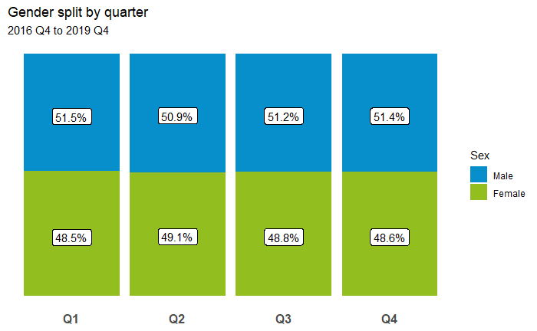
Demographics: Who gets admitted to hospital…
Roughly even split of Males and Females
Though it should be noted that there are fewer men in the older age groups (over 75’s).
Notes:
So when looking at covid deaths in males, it is a larger proportion
Males are 1.4 times more likely to die than females.

Slide 11
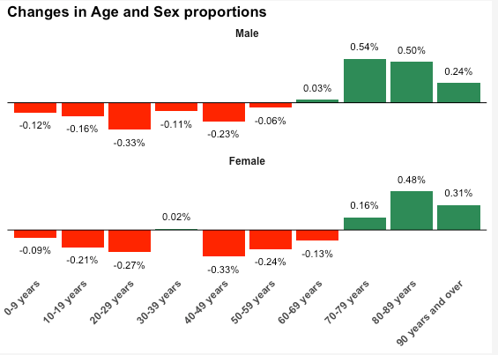
Demographics: Who gets admitted to hospital…
Increase amongst older age groups overall.
Predominantly males in the 70-79 and 80-89 age bracket; over 90’s increase is in the female cohort (is this due to females living longer?)
What time from does this cover? Is it only covid or pre-covid/covid? admissions?
Notes:
Predominantly males in the 70-79 and 80-89 age bracket; over 90’s increase is in the female cohort (is this due to females living longer?)
What time from does this cover? Is it only covid or pre-covid/covid? admissions?

Slide 12
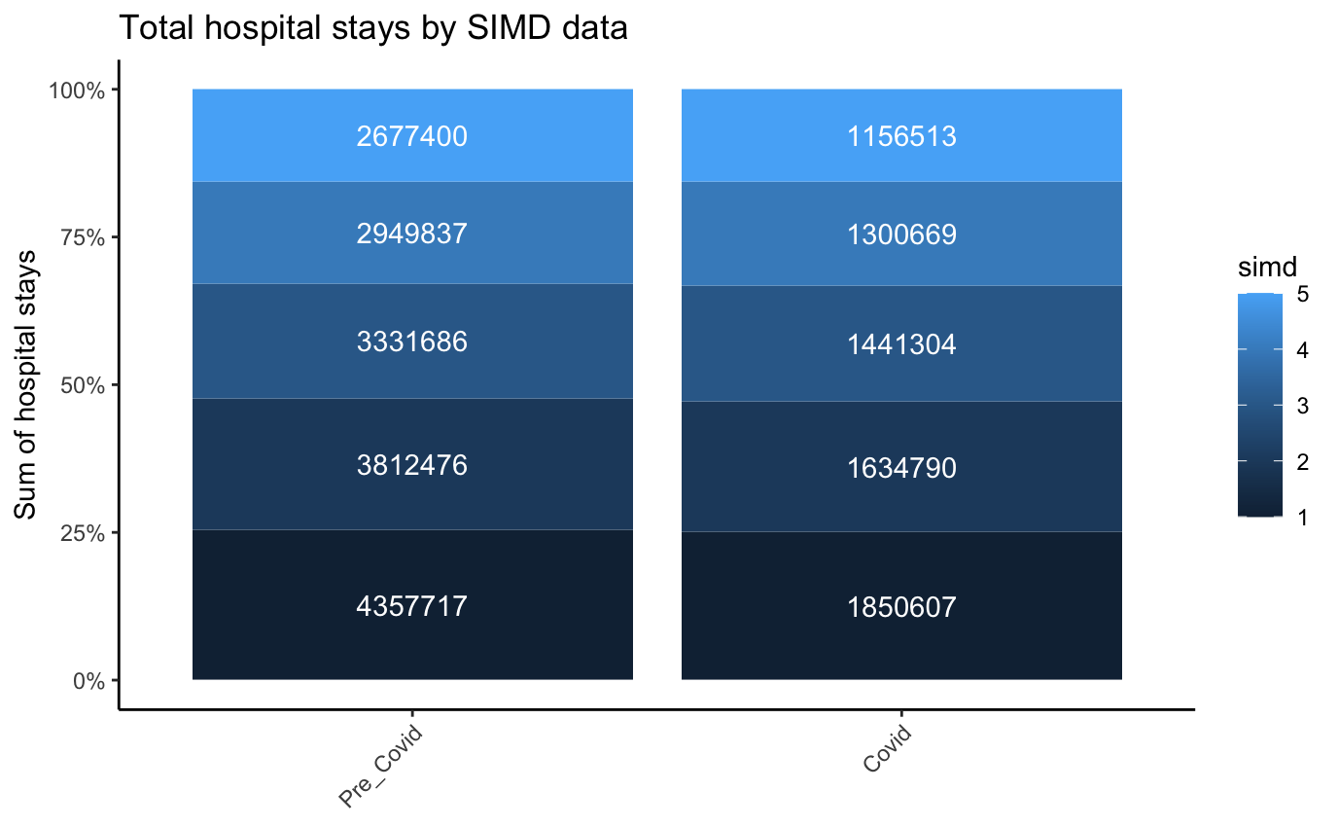
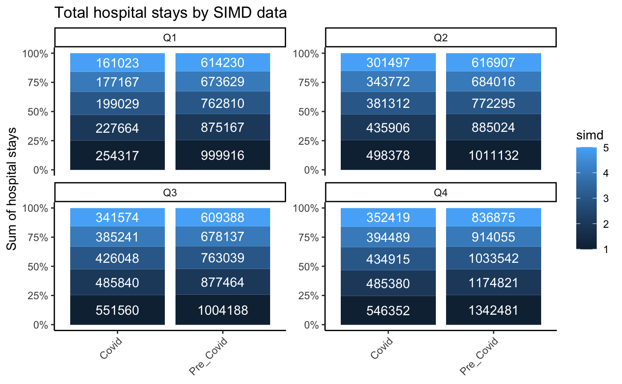
Demographics: Who gets admitted to hospital…
Notes:
What is the Scottish Index of Multiple Deprevation?
“SIMD is a a statistical tool used by local authorities, the Scottish government, the NHS and other government bodies in Scotland to support policy and decision making. - it identifies for identifying the places in Scotland where people are experiencing disadvantage across different aspects of their lives.”
Quintile 1 is most disadvantaged, 5 least deprived
The Scottish index of multiple deprivation (SIMD) is It won the Royal Statistical Society's Excellence in Official Statistics Awards in 2017.
No obvious split when looked at Pre_Covid and Covid timeframe by proportion - though I would note that there was an increase of circa 1% when looked at the Covid specific data.
Consistent evidence that 25% of admissions are from Quintile 1, ie those from the most deprived areas.
Quintile 5 by comparison consistently circa 15%
IGNORE
What is the Scottish Index of Multiple Deprevation?
“SIMD is a a statistical tool used by local authorities, the Scottish government, the NHS and other government bodies in Scotland to support policy and decision making. - it identifies for identifying the places in Scotland where people are experiencing disadvantage across different aspects of their lives.”
Quintile 1 is most disadvantaged, 5 least deprived
The Scottish index of multiple deprivation (SIMD) is It won the Royal Statistical Society's Excellence in Official Statistics Awards in 2017.

Slide 13
Impact on Hospitals

Slide 14
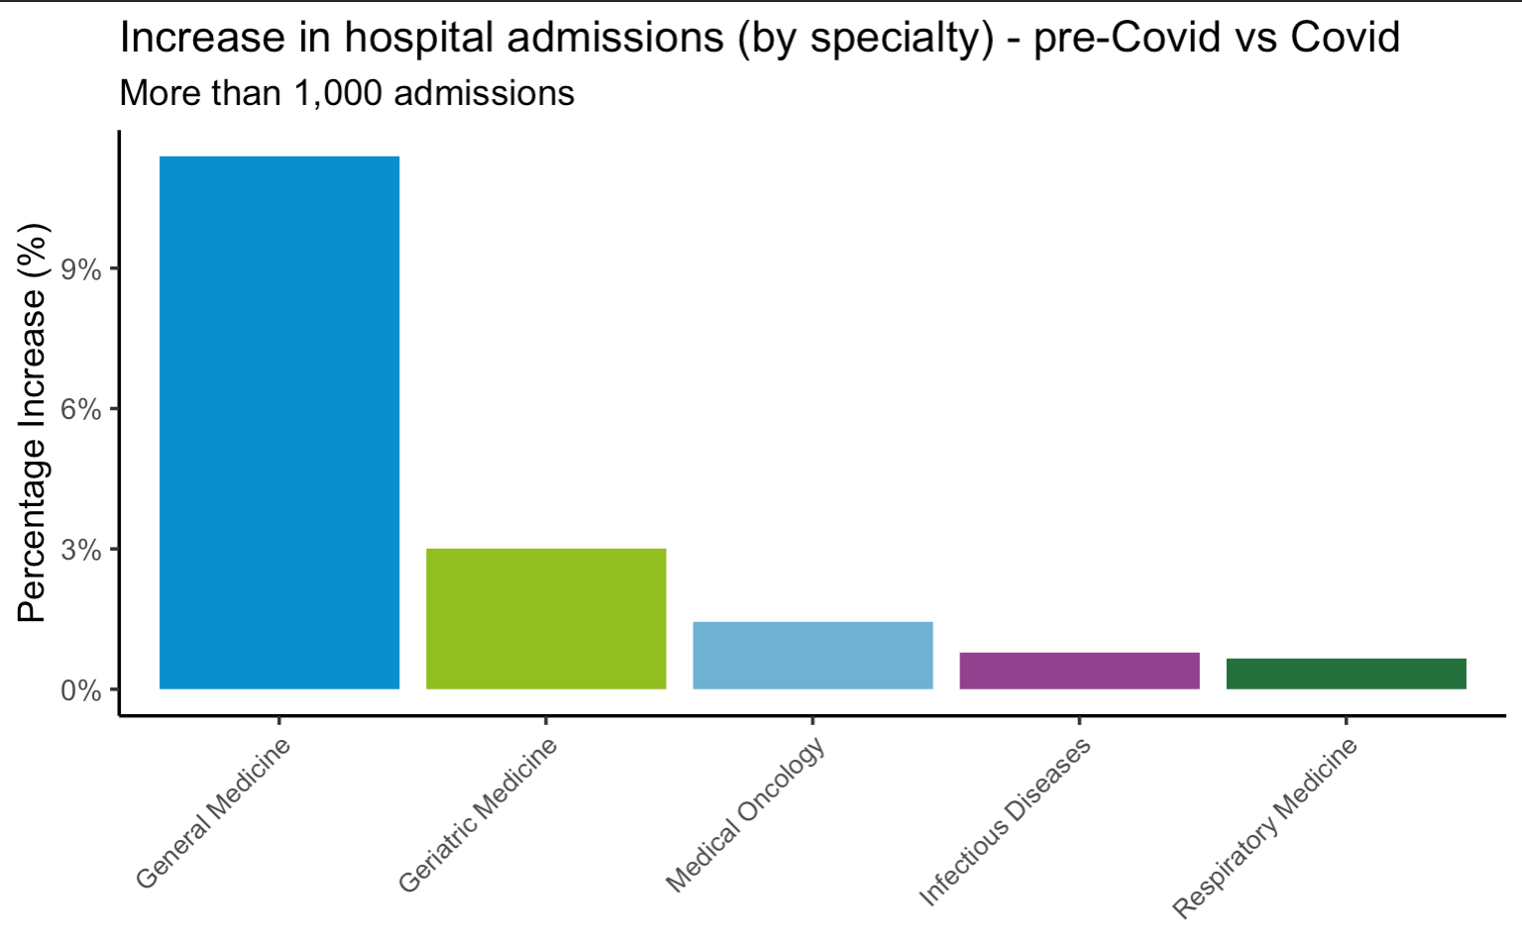
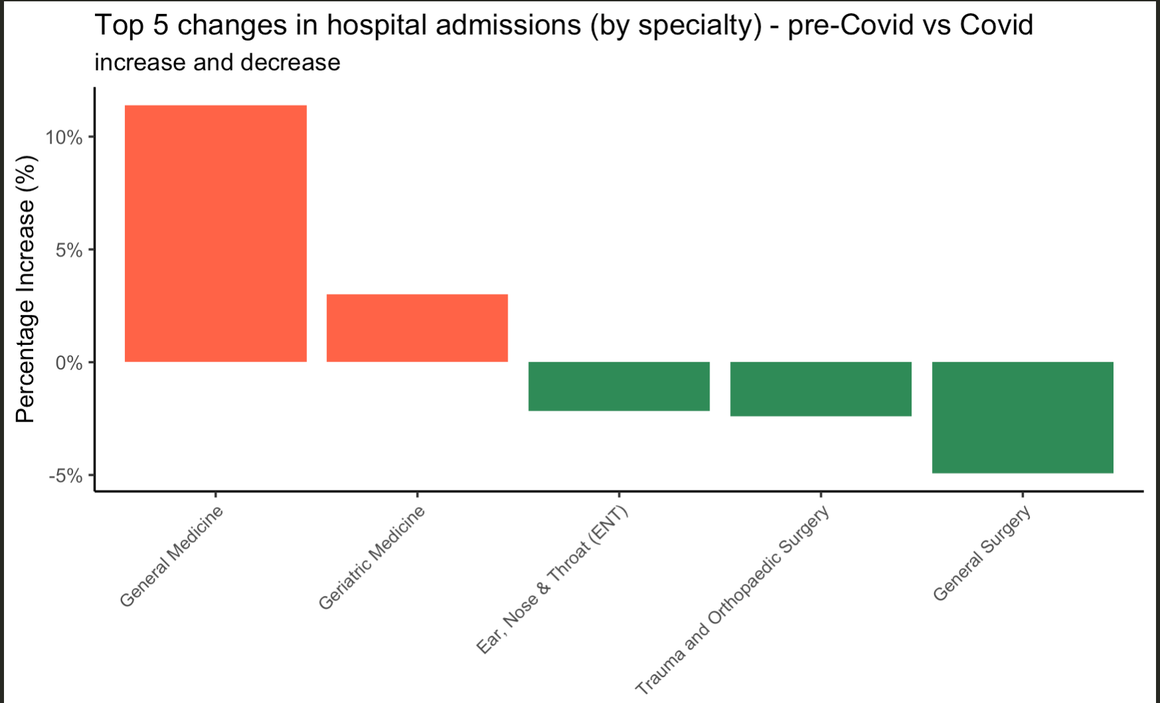
Admissions by specialty: pre-covid vs covid
-Measurement used : Changes as a percentage of total admissions
-Increase and decrease
- Why do we use this one in out dashboard

Slide 15
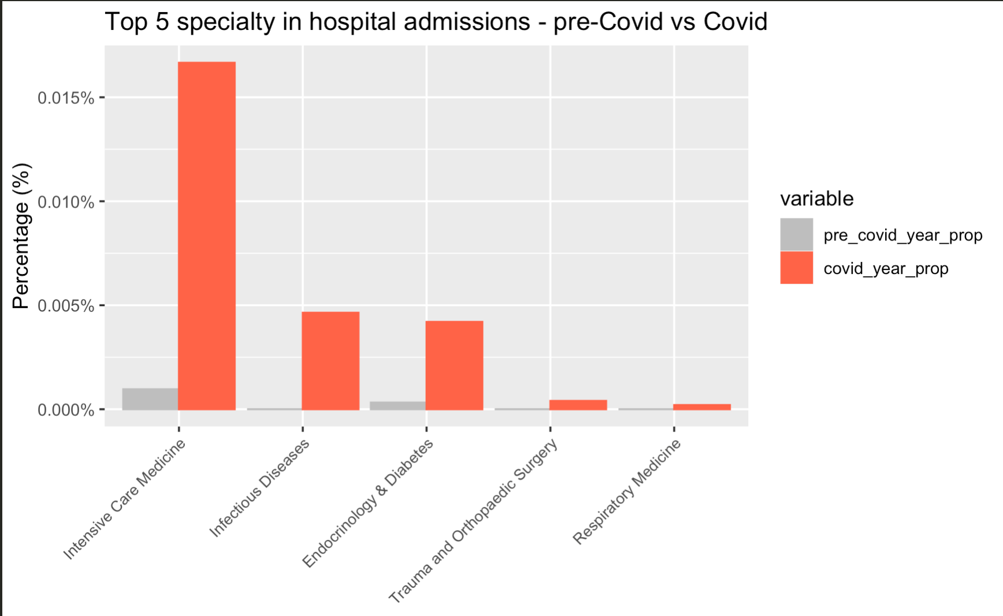
Top 5: covid time vs pre-covid
-Different measurement (changes as a percentage of pre-covid year)
-Why is this graph important too?

Slide 16
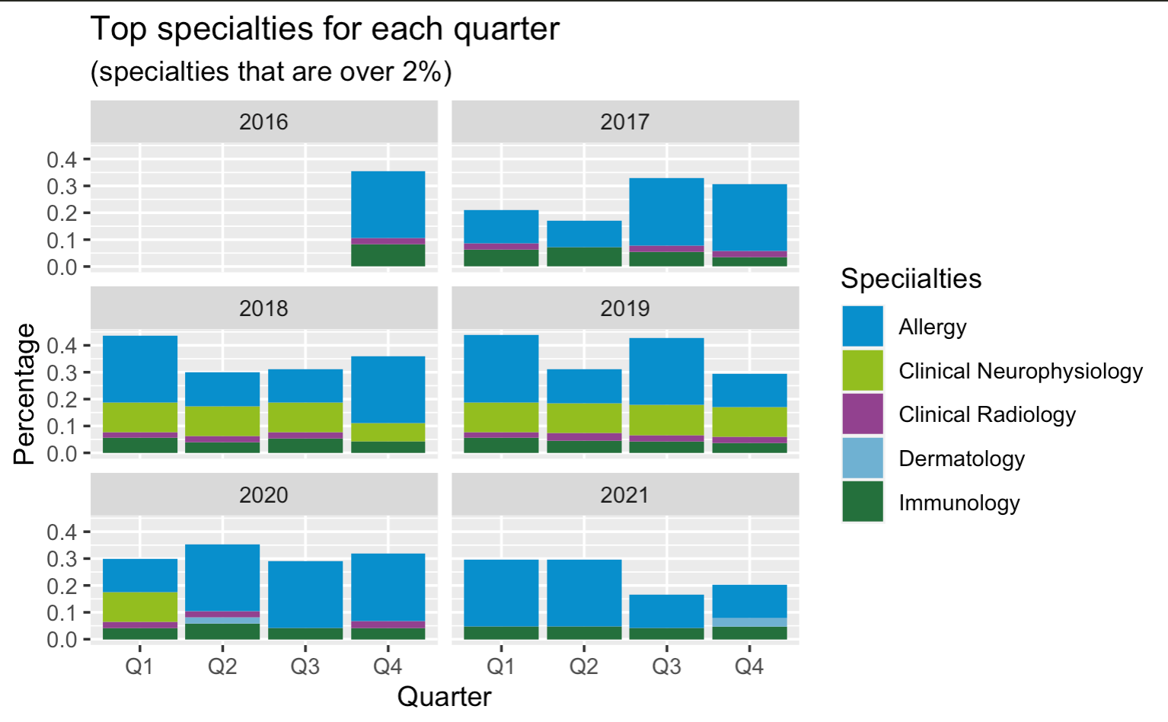
Specialties by quarter
-Measurements used
-Not much difference
-Clinical Neurophysiology, no data before 2018?

Slide 17
Hospital KPIs

Slide 18
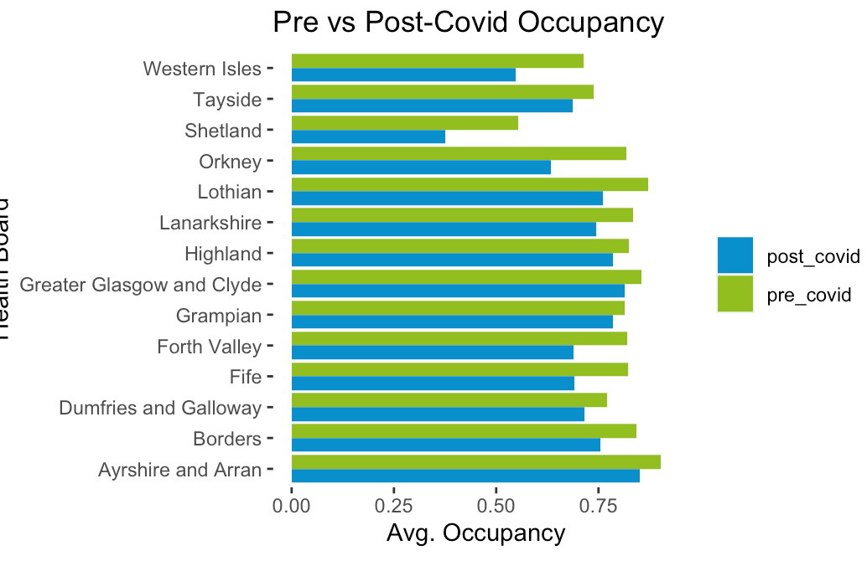
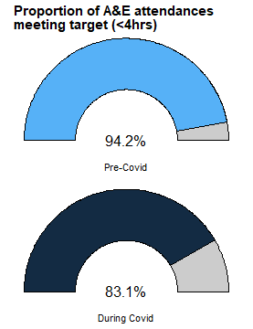
Hospital Performance Indicators
Lower occupancy since covid-19
VS
Longer wait times since covid-19

Slide 19
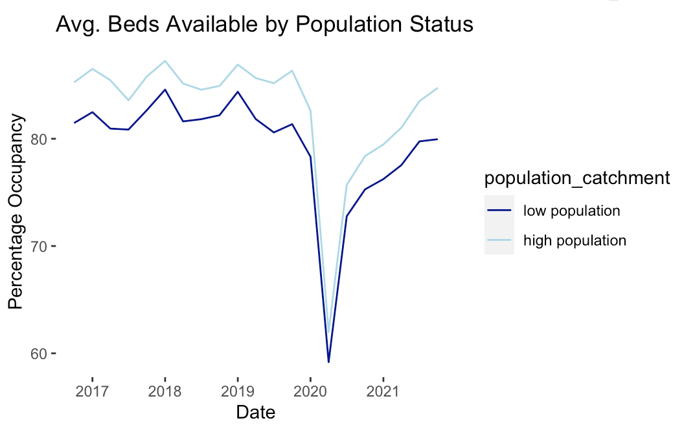
Future of Hospital Performance
High occupancy rates returning post-covid
more stress on already underperforming wait times?
What’s driving the return of high occupancy & wait time performance?
Admissions from deprived areas
IC admissions increase
Age of admissions
Covid’s effect on seasonal fluctuations
85%

Slide 20
Summary

Slide 21
Summary
Seasonal trends:
Higher proportion of males attending hospitals in winter (51.4%)
Older age groups (over 60s) represent a large proportion of hospital visits
Impact of Covid:
On demographics
Total attendance has reduced
Higher attendance rates of males and females over the age of 70
On hospitals:
Proportions of specialties relating to covid treatment have increased significantly
Bed occupancy is on the rise
A&E waiting times are getting longer

